Slide 1
Intermediate Typescript
Generics & Mapped Types

Slide 2
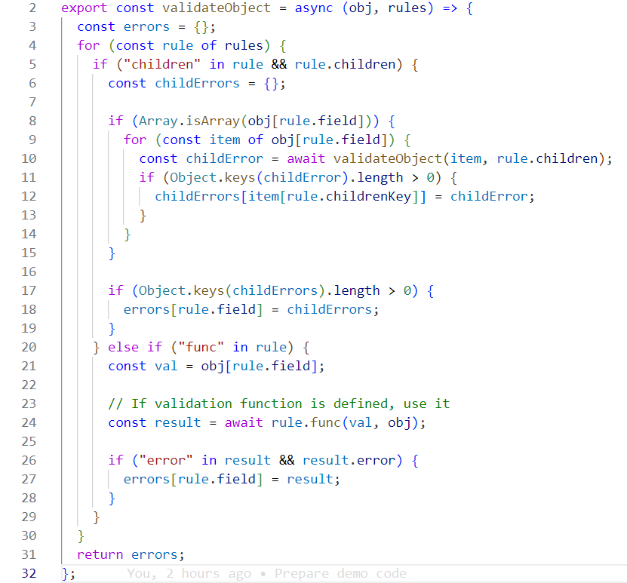
Motivation
Existing untyped validation code

Slide 3
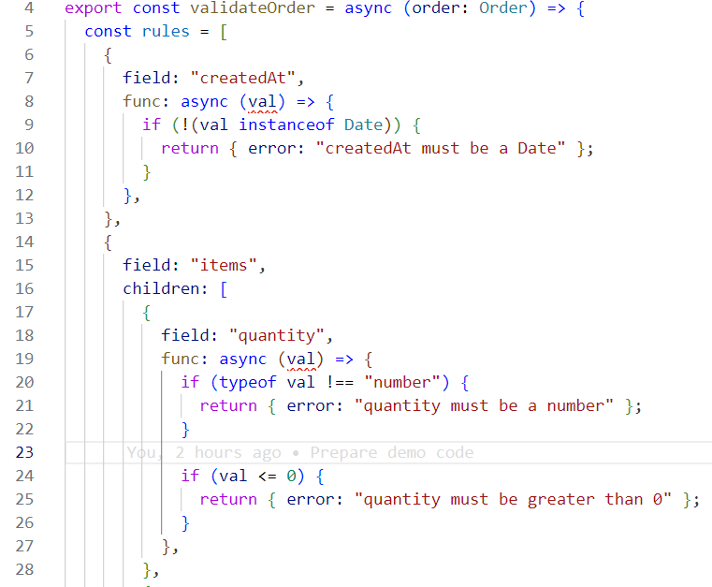
Motivation
Unchecked rule definitions

Slide 4
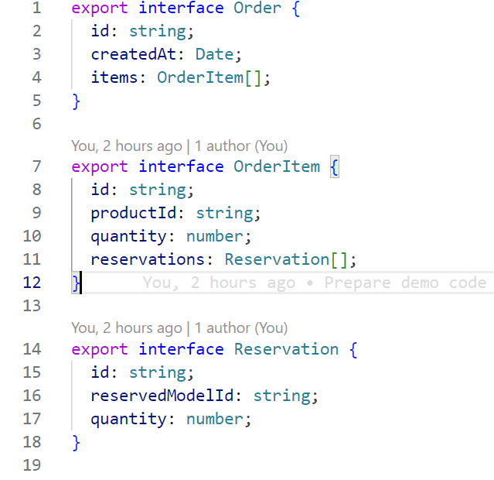
Order model
What we will be validating

Slide 5
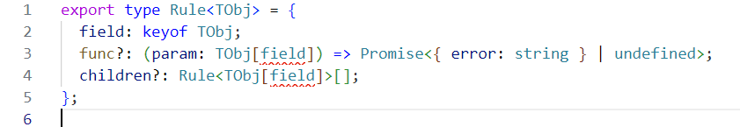
Attempt #1
Generics
Wrong syntax ☹

Slide 6
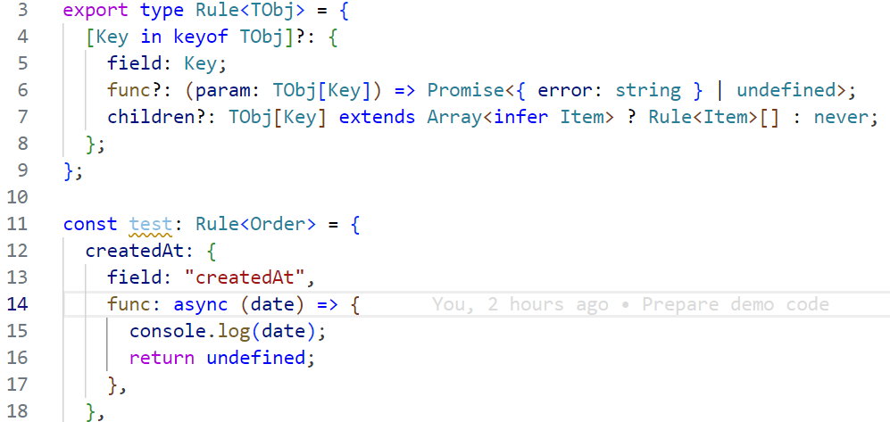
Attempt #2
Mapped types
Changes the API ☹

Slide 7
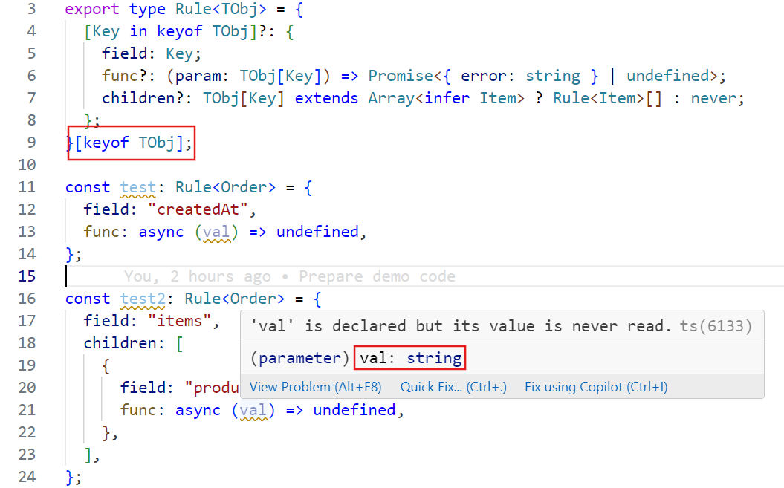
Attempt #3
Indexed Access Types
Works ☺

Slide 8
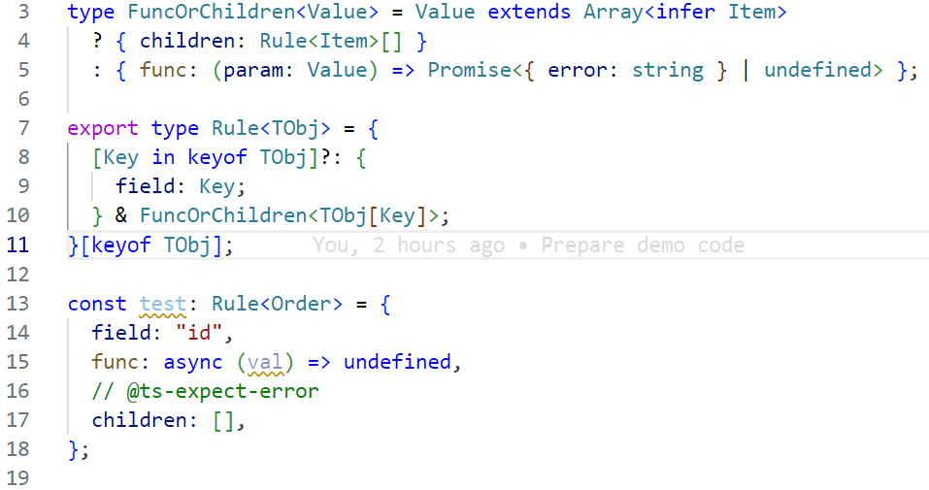
Attempt #4
Better validations

Slide 9

Robert Gemrot
Metio Software s.r.o.
Lecture on Github
LinkedIn

